Slide 1
The Zen of Coding
Day 1
The Coding Bootcamp

Slide 2
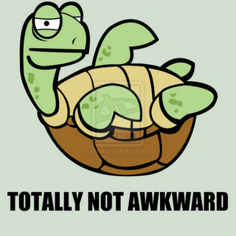
Quick Introductions! (30 seconds)
Name
Location
Background (Career, Education, Interests)
Why learn web development?
Excited about class?
Notes:
This class is, after all, about you – so let’s do some introductions.
(You may also want to ask “Fears about class?” – that can turn a little negative, so be ready to dissuade/make happy the students if you do ask this)

Slide 3
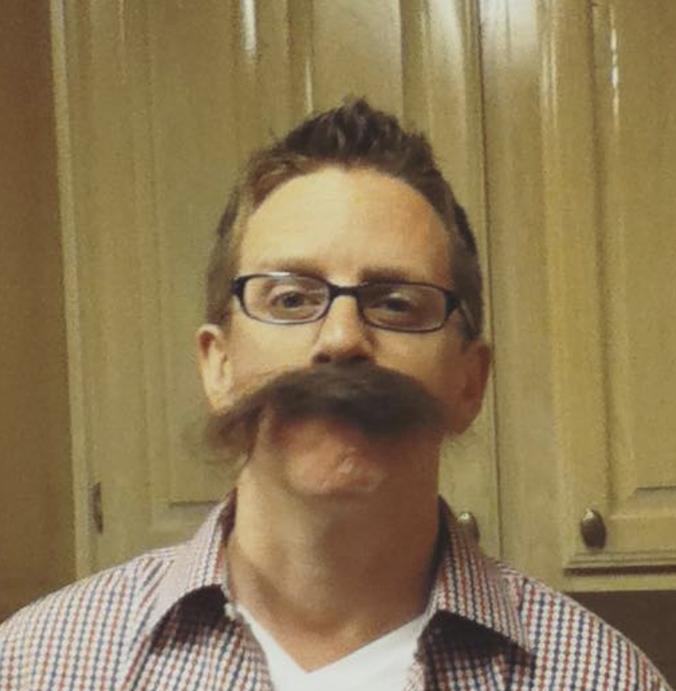
Instructor = … ?
Jon Lynch
Art Institute of Dallas Multimedia, Graduated 2002
Champlain College - Burlington, VT Software Development, Graduated… soonish)
Over 15 years coding, (with plenty of experience being a n00b at it.)
Directly related to 👑 King Alfred the Great of England (No, I didn’t get any money 😭)
Secretly, a Call of Duty addict.
Notes:
Enough about you, time to talk about me.

Slide 4

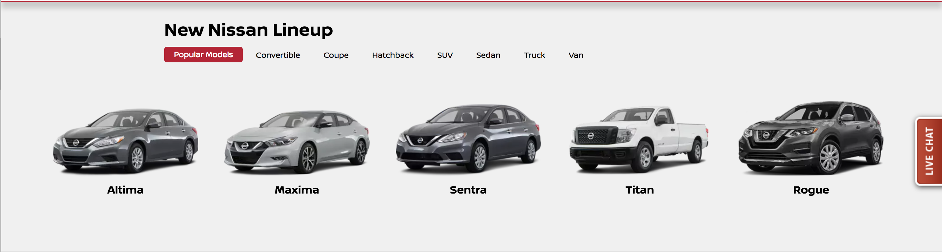
Some Cool Stuff I Made…
Notes:
Here’s this cool thing I built. It does X and it’s important because Y.
Questions?

Slide 5
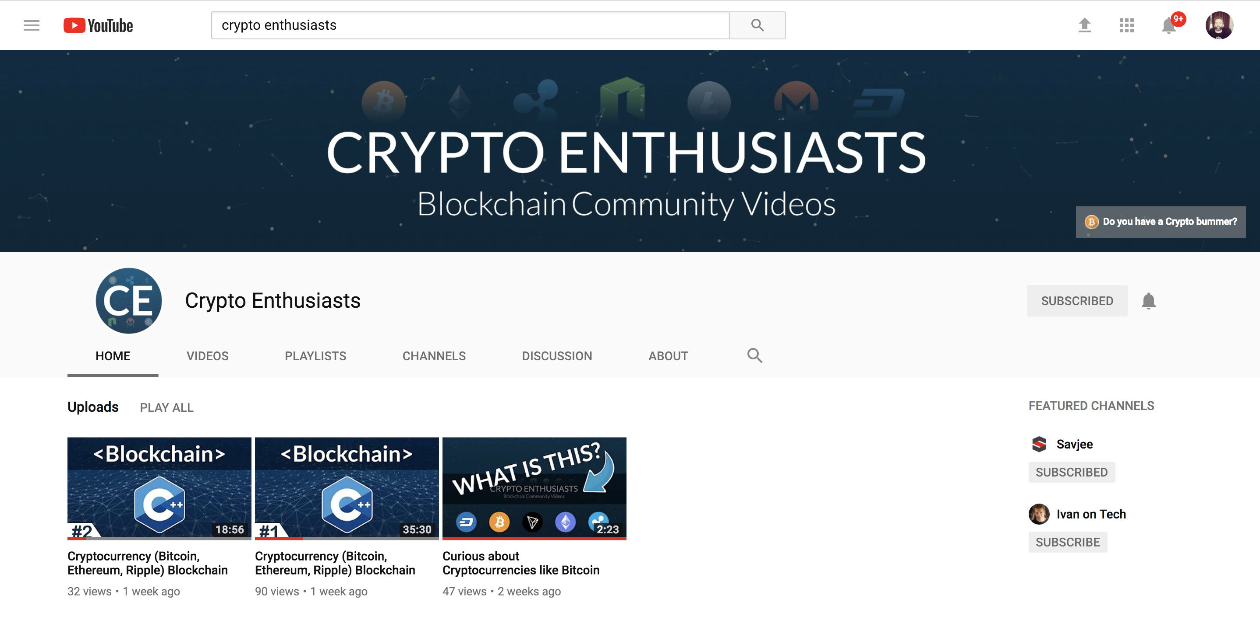
Some Cool Stuff I Made…

Slide 6
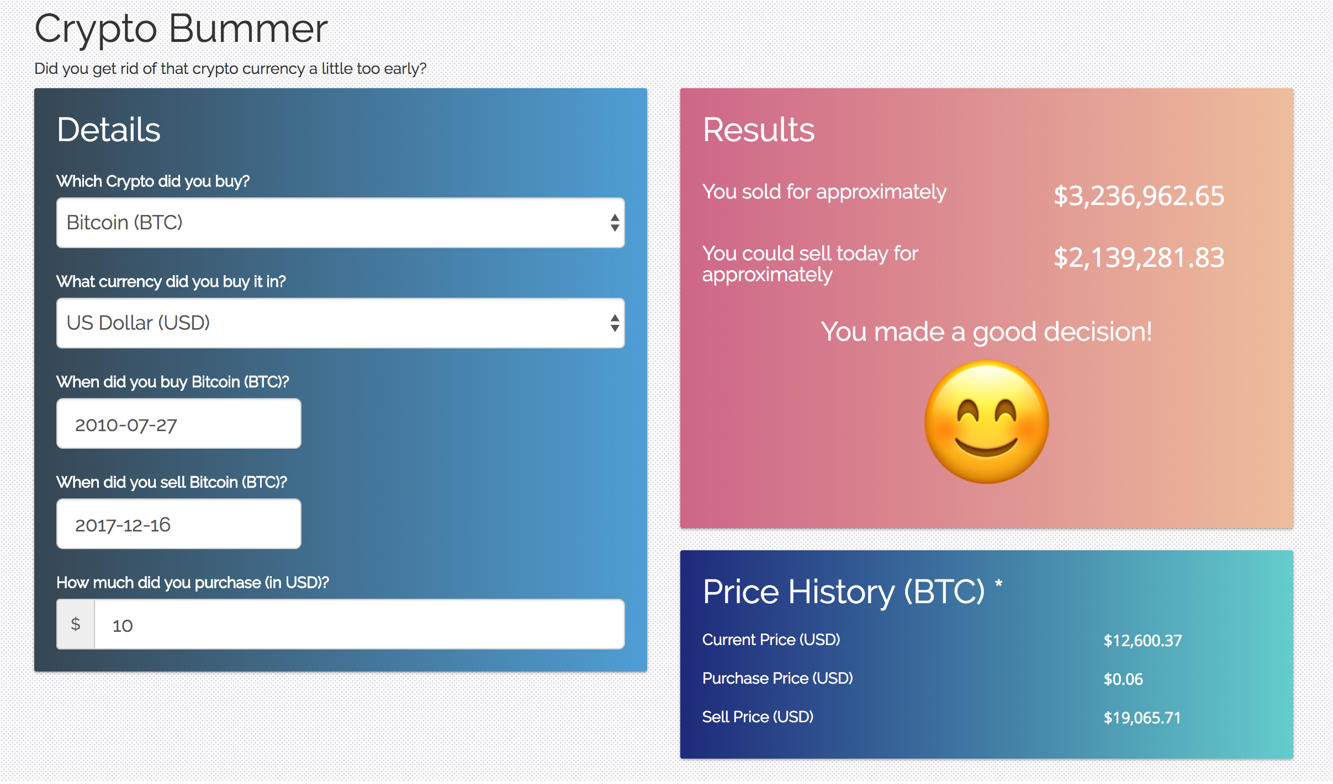
Some Cool Stuff I Made…

Slide 7
The Path of Learning
Notes:
It’s important to keep in mind why you joined this class. Let’s talk about your goals.

Slide 8
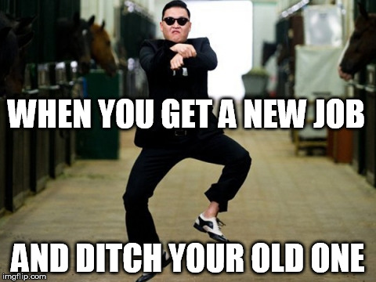
Your Goals...
New Career
Basically 1000% of you said…

Slide 9
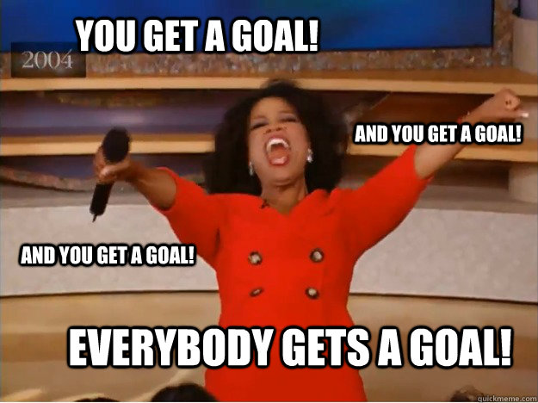
Your Goals...
And why do you want a new career?
To escape a “dead-end job”
To pursue a “dream”
To be able to “create”
To follow a “fascination”
To attain “financial stability”
To attain “financial freedom”
To “challenge” yourself
To be a “role model” for kids

Slide 10
Your Goal = Our Goal
As instructors,
we take your goals very, very seriously.

Slide 11
Support Team
Our Promise:
If you’re willing to put in the time – and you take our advice, we’re here to help you 100% of the way.
This goes for everyone working behind the program:
Instructors
TAs
Student Success Team
Career Coaches
Everyone Else!
Notes:
This program will not be a traditional college class. We're here to support you 100% of the way to really help you achieve their goals.

Slide 12
But Remember…
Nothing good comes easy.
Notes:
There are a few things you can do to ensure your success

Slide 13
On Keys To Success…

Slide 14
Don’t Be This Guy…
Notes:
First off, don’t be this guy.
Those that have the hardest time in the program are not the ones who came in knowing no programming.
It’s not the ones who haven’t played around with HTML, CSS, or Javascript.
It’s the ones who walk in thinking they either A) Know more than they do. Or B) Are experts in a completely different field.
There is something that stops people like this from accepting the reality.

Slide 15

This Should Be You.
Notes:
Be this guy. Having a humble attitude is the first requirement of being successful in this program.

Slide 16
Our Mantra for Today and Beyond…
When it comes to web development…

Slide 17
Our Mantra for Today and Beyond…
I know nothing.
Notes:
Don’t be frustrated! Keep an open mind – you’re here to learn.
You mastery of other subjects, educational backgrounds, and professional successes do not guarantee that you will do well here. The only thing that will guarantee success is hard work, humility, and a relentless desire to be better.

Slide 18
You.
Notes:
You are a blank slate. Seriously. Don’t lose sight of this image. At first it may feel intimidating. Knowing how little you know. But relish the opportunity and take the privileges it comes with.
You have permission to struggle. To fail. To not “get” everything immediately.

Slide 19
The Path of Learning
Notes:
So how does one learn? Well…

Slide 20
Nothing Comes Easy…
As students, you face three
HUGE obstacles!
Notes:
… there are a few obstacles in the way.
Things that will frustrate you…

Slide 21
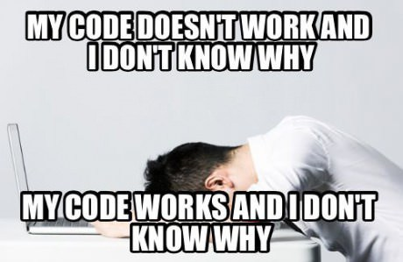
Obstacle #1 – The Great Confusion
Notes:
Obstacle 1 First, learning to code is tough, intimidating, and frustrating at times. You should forget about your uncle/brother-in-law/friend/step-sister who told you about so-and-so learning to build apps in 1 week. Coding is hard. It will take time. There is no way around that.
It’s confusing, difficult, and there’s a ton to learn. But it’s super rewarding when you _do_ learn why your code broke or is working.

Slide 22
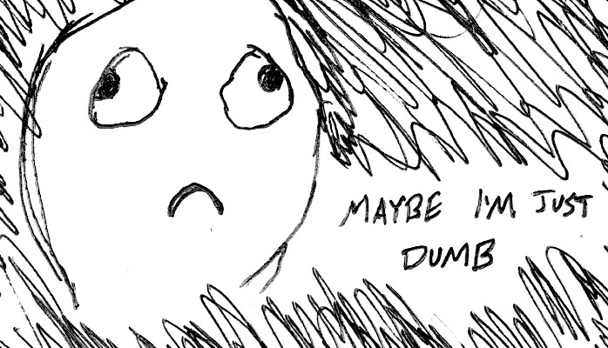
Obstacle #2 – The Great Doubt
Notes:
Obstacle 2
There will be many moments where you will doubt yourself.
Everyone is on the same page as you. No-one in this classroom is dumb. You all have varying backgrounds with differing experiences and exposure.
Everyone was where you are at some point in their career. Every single developer. Me too.
It takes time but you have what it takes; you were selected for this program because we know you have what it takes.
The first few weeks will be difficult, but everyone will be on a pretty level playing field a few weeks in.

Slide 23

Obstacle #3 – The Great Distance
Notes:
Obstacle 2 – you have a ton of ground to cover!
There’s a lot to learn, and it can be intimidating. But honestly, 6 months will be over before you know it.
Because of the length of the program, personal issues WILL come up during the course of the program, and it will be challenging to stay motivated.
You should see each other as a family embarking on a long journey. You will become far closer to your peers than you realize. Intensity is no substitute for endurance.

Slide 24
Nothing Comes Easy…
Learning to Code Requires Two Things:
Persisting in the face of something that feels incredibly hard and confusing.
Maintaining the self-confidence necessary to believe that you CAN DO THIS.
Notes:
And will take a while to master. Persisting in general is the #1 hardest thing in this course.
Perhaps tied with having self-confidence (talk about imposter syndrome).

Slide 25
Learning is “Frustrating”
“You can’t tell whether you’re learning something when you’re learning it—in fact, learning feels a lot more like frustration.”
“What I’ve learned is that during this period of frustration is actually when people improve the most, and their improvements are usually obvious to an outsider. If you feel frustrated while trying to understand new concepts, try to remember that it might not feel like it, but you’re probably rapidly expanding your knowledge.”
Jeff Dickey, Author of Write Modern Web Apps with the MEAN Stack: Mongo, Express, AngularJS, and Node.JS
Notes:
Frustration = learning, seriously. Here’s the author of a pretty famous book on the mean stack:
So how do we get through this frustration and actually learn?

Slide 26
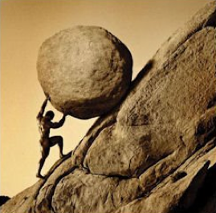
Advice for the Journey
Throughout this course, always remember to:
Work Hard!!

Slide 27
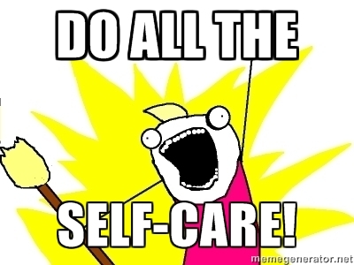
Advice for the Journey
Throughout this course, always remember to:
Work Hard!!
Appreciate your successes

Slide 28

Advice for the Journey
Throughout this course, always remember to:
Work Hard!!
Appreciate your successes
Trust yourself
Notes:
Questions?

Slide 29
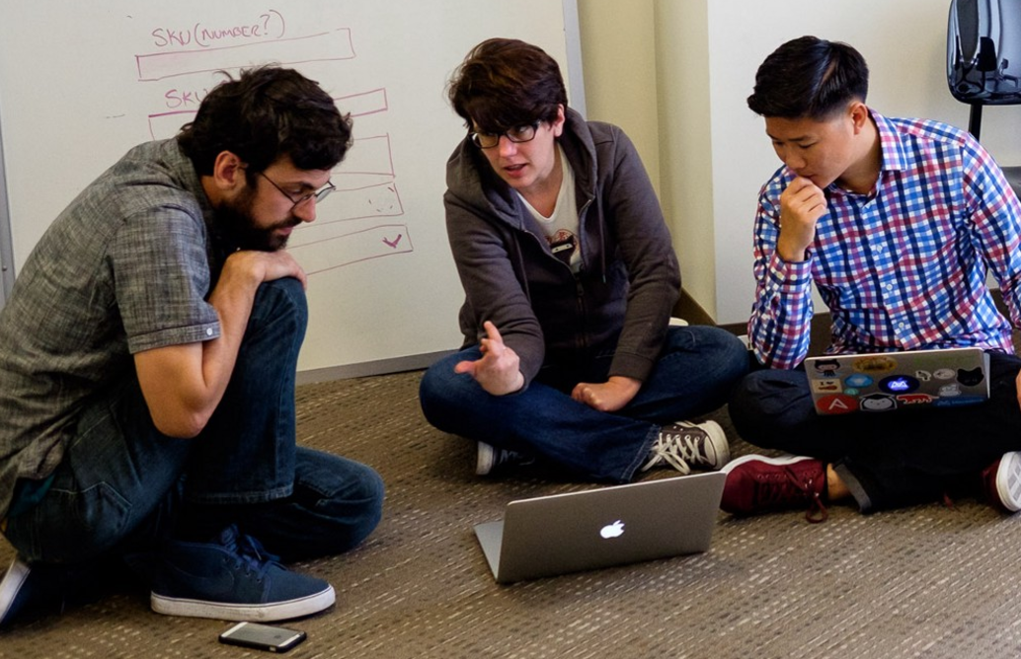
But remember…
If you want to go fast, go alone.
If you want to go far, go in a team.

Slide 30

Google Fu – The Most Important Skill of All
What is Google Fu?
Notes:
Of course, to do this, you’ll need to be great at googling!
This is arguably the best/most important skill you can use.
It’s silly, but being able to find the answers to your questions is extremely important, and people won’t always be around. Google should almost always be your first go-to (it has almost every answer, if you know how to find it).

Slide 31
Course Structure
Notes:
Now that we’ve talked about the journey and how to be successful, let’s talk about the stops along the way.

Slide 32
Daily Schedule
For each class we’ll run through the following:
Set Objectives
Brief Background Lecture
Watch Me / Coding Demos
Code Discussions
In-Class Exercises
Project Work
Notes:
Here’s what our days will look like.
Question: How do you learn to code? (NEXT)

Slide 33
Daily Schedule
For each class we’ll run through the following:
Set Objectives
Brief Background Lecture
Watch Me / Coding Demos
Code Discussions
In-Class Exercises
Project Work
The Super Important Stuff!!!
i.e. Always be coding!
Notes:
By coding! Unfortunate, right?
We’ll get a ton of in-class practice reading and writing code, so the course quickly becomes “code-centric”.
Most days will be much less presentation-heavy than today.
Questions?

Slide 34
Pre-Work
Notes:
So next up I want to spend a little bit of time checking that everyone has everything they need installed (from the pre-work).
If you can check off all of these things, spend this time helping your neighbors. This should become a habit – try to ask for help form your neighbors before going to a TA (you will both learn more along the way). < We’ll talk more about this soon.
That said, let’s check some things off of a list.

Slide 35
Software Checklist
At this point, you should have each of these installed:
Slack
Visual Studio Code
Git for Version Control
Git Bash (Windows) or Terminal (Mac)
Node.js
Heroku-CLI
Google Chrome

Slide 36
Accounts Checklist
You should also now have accounts for:
GitHub (with SSH Integration)
Heroku
LinkedIn
Stack Overflow

Slide 37
Self-Check
Let’s do some quick checks of the following
Sublime Check
Git Bash / Terminal Check
Node Check
Git Check
Heroku Check

Slide 38
On the Modern Web

Slide 39

Full-Stack Development?
Notes:
So what exactly does it mean to be a “full stack developer?”

Slide 40
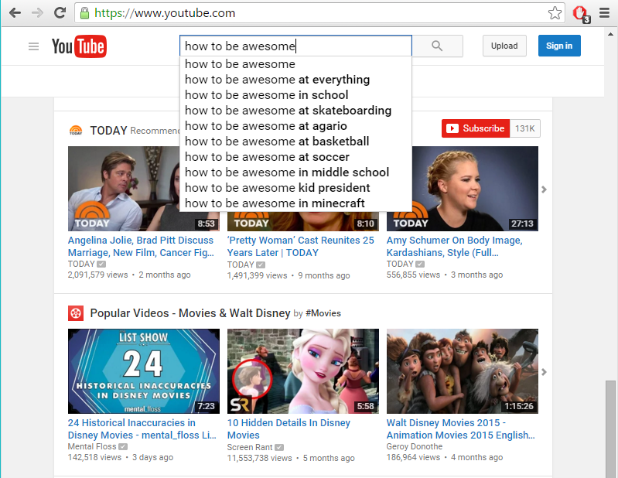
The “Magic” of YouTube
Notes:
Let’s use YouTube as an example. (Go to YouTube and do basic search)
You’ll learn all of this in time, but a basic YouTube search requires two things:
A ”frontend” – the graphical user interface which responds to what I type
A “backend” – the code on the “server side” that is able to do the logic behind the search, find the relevant videos, and send them along
(Go to next slide)

Slide 41
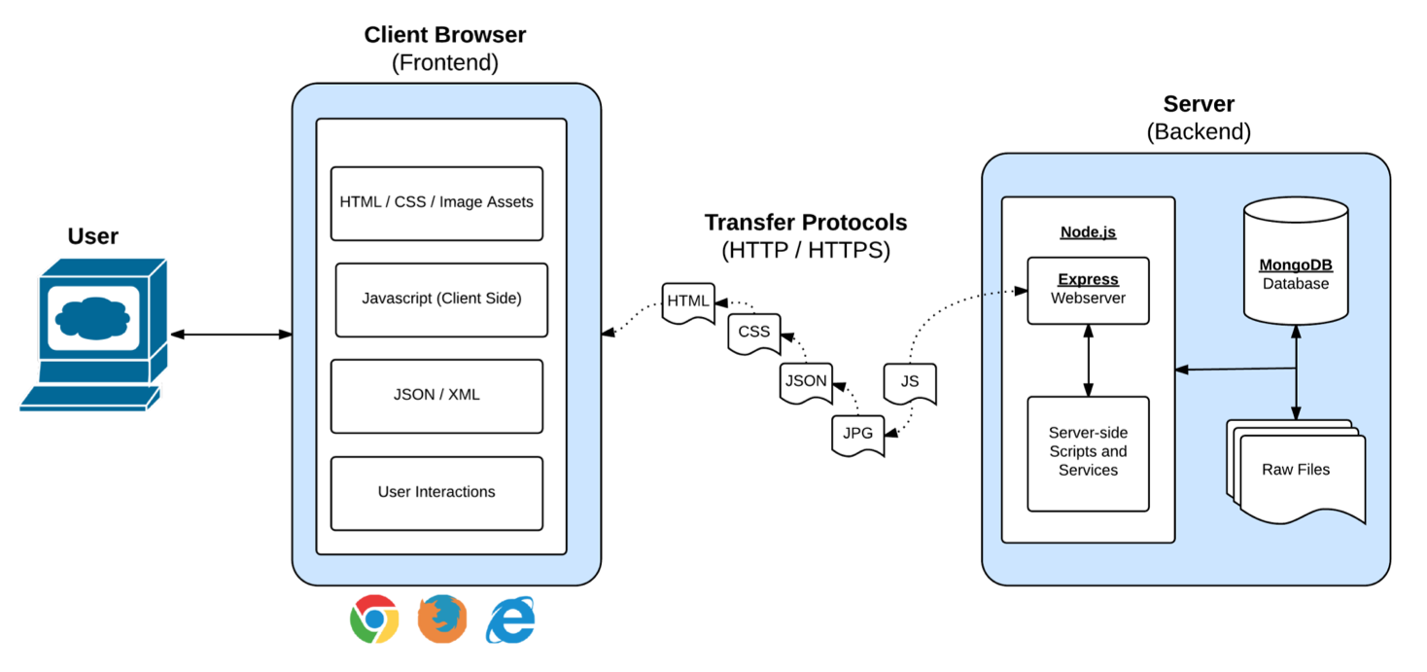
Full-Stack Development
In modern web apps, there’s a constant back-and-forth communication between two key components: the visuals displayed on the user’s browser (frontend) and the data and logic stored on the server (backend).
Notes:
Websites today are all about reading code for these components – “frontend” and “backend”

Slide 42
Full-Stack Development
Full-Stack Development is the concept of building every aspect of the web application – from the visuals and interactions, to the data transfer and processing.
Notes:
That is “Full-Stack Development” – you build can and will build the whole thing.

Slide 43
Full-Stack Development
The Browser
Dev Tools
Server Side
HTML
CSS
JavaScript
jQuery
Bootstrap
SEO
Heroku
Git
GitHub
Templating Engines
Sessions
Writing tests
Node.js
Express.js
Creating APIs
MVC
User Authentication
ORM (Sequelize)
Databases
MySQL
MongoDB
API Interaction
APIs (Consuming)
JSON
AJAX
Real Time Cloud Database via Firebase
Algorithms
Design Patterns
CS Fundamentals
Cutting Edge Development
React.js
Notes:
In this course, you’ll learn everything you need to be able to do this –
you’ll be able to build complex web applications even as a single developer.
Questions?

Slide 44
Let’s Get Crackin!

Slide 45
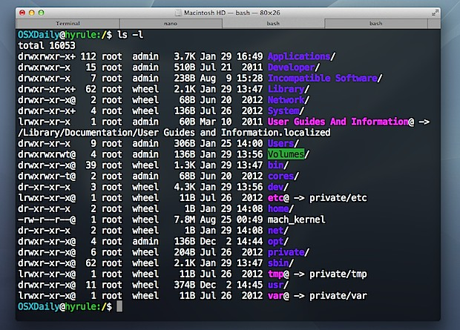
Intro to Console / Terminal
Notes:
The terminal is the portal to your computer – it allows you to run and even script commands that can create files, folders, and more.
It is extremely important that you get intimately familiar with the terminal as soon as possible, as you’ll use it for almost everything. It is fast and powerful.
NEXT

Slide 46
INSTRUCTOR DEMO
Instructor: Demo
(1-ConsoleCommands)
Notes:
So let’s run through a couple of examples.

Slide 47
> YOUR TURN!
Activity: Get Situated | Suggested Time: 1 min
Assignment:
Make a folder on your desktop named code.
Put all of your code that you do inside of that folder.
Best Practices:
Always use lowercase for folder and file names.
Never put in spaces in your folder and file names.
Use dashes to separate.
Notes:
Your turn!

Slide 48
> YOUR TURN!
Activity: Console Commands | Suggested Time: 12 min
Assignment:
From the Terminal / Console and using only the command line, create:
A new folder with the name of first_day_stuff.
A new HTML file with the name of first_day.html.
Open the current folder containing the new HTML file.
Bonus:
Create multiple directories/folders with the names one_folder and second_folder in one command.
Create multiple files with the names one.html and two.html in one command in the first_day_stuff directory.

Slide 49
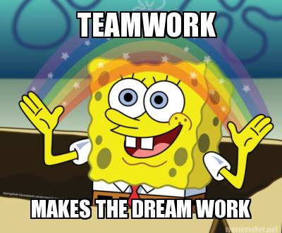
Intro to Console
Discuss with Neighbors
Notes:
Re-ask the questions after a couple of minutes walking neighbor-discussion:
How do you create a new folder?
How do you create a new file?

Slide 50
Hello, HTML
Notes:
Now that you can create HTML files from the terminal, let’s create one and actually write some HTML.

Slide 51

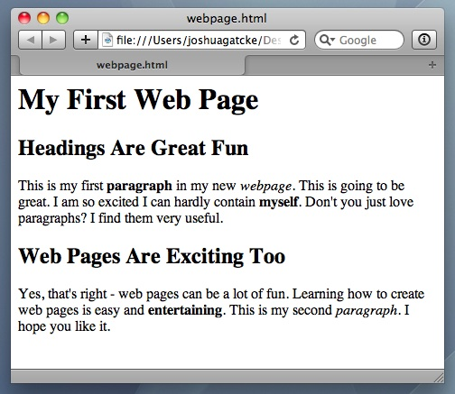
<title> Intro to HTML </title>
HTML is one of the three base languages behind every single website.
It defines all of the basic content and a bit of formatting.

Slide 52
> YOUR TURN
Assignment:
In a new HTML file, create the basic structure of an HTML document and include the following in it:
DOCTYPE declaration.
Head tag with a title tag.
H1 tag with a title of your choice.
Embed an image.
Create the following three links on your page:
One link that is target="_blank" so that it opens a new tab when clicked on.
Make the second link bold.
Make the third link a placeholder so it goes nowhere.
Bonus:
Create an ordered list of steps to make a sandwich.
Create an unordered list of 5 bands/musicians you like.
Create a table with 2 columns (animal class and animal name) and 4 rows of animals.
Use an alternate way of separating links without line breaks.
Embed a YouTube video of your favorite band/musician.

Slide 53
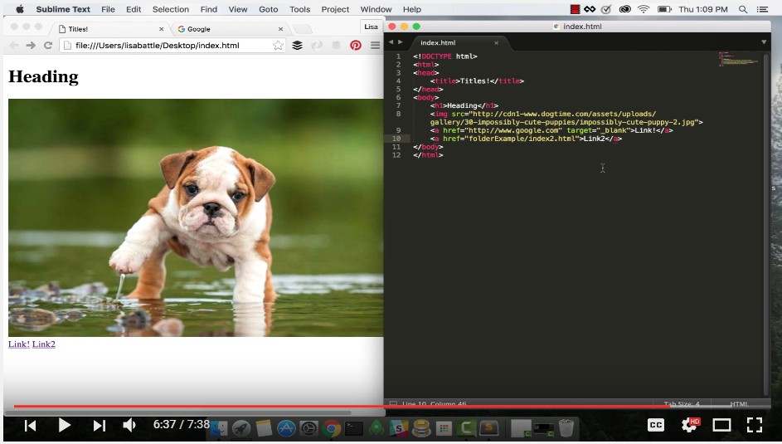
YouTube Video Walkthrough!
https://www.youtube.com/watch?v=ieb6Svbc10E&index=1&list=PLgJ8UgkiorCnMLsUevoQRxH8t9bt7ne14

Slide 54
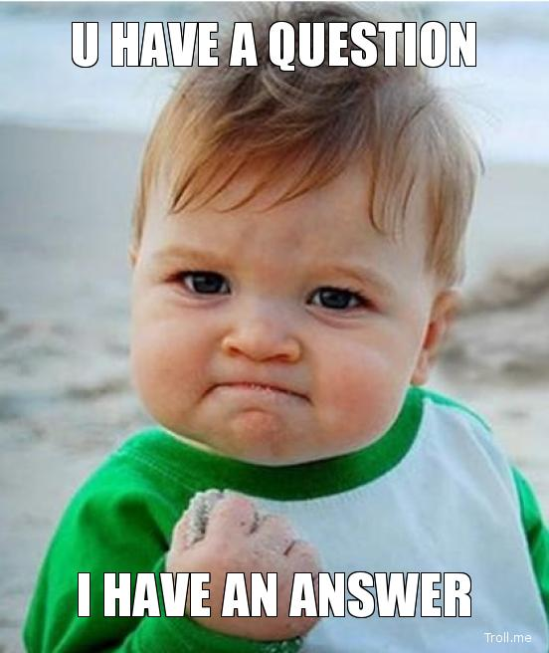
<title> Intro to HTML </title>
How’d it go?

Slide 55
Homework!

Slide 56
Homework “Due”: Next Class
By Next Class:
Figure out where the GitHub Repo is for our class.
Re-do the Terminal example from class today.
Re-do the HTML example from class today.
Watch the Walkthrough Video if you felt a bit lost.

